Slide 1

Azure Primer
You can’t put applications on bare metal… You need a primer coat first.

Slide 2


Scott Corio
Enterprise Cloud Architect, Microsoft MVP – Azure (Cloud Native/PowerShell)
scottcorio
DumpsterDave
https://blog.shitstormbrewing.beer
Chad Lich
Director Azure Infrastructure Specialist
chad-lich-72378bb
bluesky4x4
I Don’t Internet

Slide 3
Housekeeping
Can’t Hear us? Can’t see the slides/content? Please let us know
Clarifying questions during the presentation are welcome
There will be a 10-15 minute Q&A for detailed/use-case-specific questions at the end.

Slide 4
Establishing a Baseline and Level Setting Expectations

Slide 5
Our Assumptions
Your familiarity with Azure ranges from “Isn’t it just a color?” to, “What does this button do and how much is it going to cost me when I click it?”
You may be tasked with doing some things in Azure directly
You may need to ask another group for resources but don’t know what to ask for
You will have questions that aren’t covered by these slides (There’s a LOT of Azure)
You agree that Bourbon is best served neat or on a single large ice cube

Slide 6
Some Topics We’ll Cover
Networking and Connectivity
Private Endpoints, DNS, Virtual Networks, Peering
Infrastructure and Platform Services
Iaas, PaaS, VMs, App Services, Storage
Governance & Compliance
Policy, RBAC, Templates, Cost Management
Automation
PowerShell, Templates, Azure Automation, Logic Apps
Security & Monitoring
ESU, Azure Monitor, Sentinel, Log Analytics

Slide 7
But First…
A bit of an Overview of Azure

Slide 8

Shared responsibility
Customer responsibility
Shared
responsibility
Microsoft responsibility
Notes:
In an on-premises datacenter, you own the whole stack.
As you move to the cloud some responsibilities transfer to Microsoft.
This diagram illustrates the areas of responsibility between you and Microsoft, according to the type of deployment of your stack.
For all cloud deployment types, you own your data and identities. You're responsible for protecting the security of your data and identities, on-premises resources, and the cloud components you control. Cloud components you control vary by service type.
Regardless of the type of deployment, you always retain the following responsibilities:
Data
Endpoints
Account
Access management
Shared responsibility in the cloud - Microsoft Azure | Microsoft Learn
https://learn.microsoft.com/en-us/azure/security/fundamentals/shared-responsibility

Slide 9
*aaS
Virtual Machines are… Virtual Machines (IaaS)
Fundamentally identical to what you’ve been doing since Grandpa stopped using punch cards
Databases can be deployed on a VM or as a platform offering (IaaS/Paas)
Platform offerings are typically much cheaper to run and license
Platform offerings do not have 100% feature parity with their IaaS counterparts
Native container options are expansive and VERY feature rich (PaaS)
Storage is still the same old dog (IaaS/PaaS)
but it has learned some new tricks

Slide 10







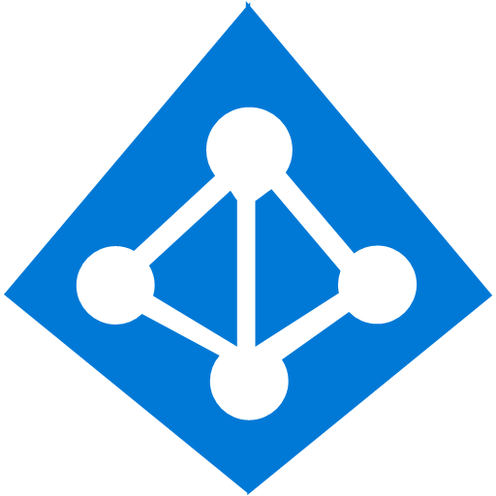























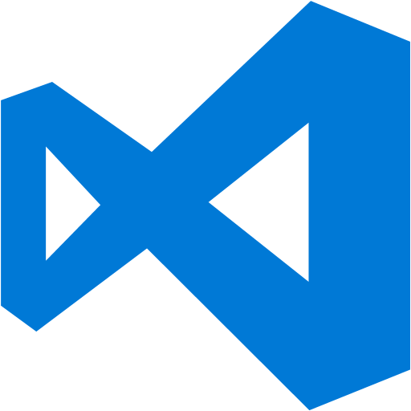























Platform Services
Security & Management
Services Compute
Web and Mobile
Data
Hybrid
Operations
Cloud
Services
Service
Fabric
Web Apps
API Apps
Portal
SQL
Database
Data
Warehouse
Document DB
Azure Entra ID
Health Monitoring
Azure Entra ID
Batch
RemoteApp
AD Privileged
Identity
Management
Mobile
Apps
Logic Apps
Redis
Cache
Azure
Search
Storage
Tables
Azure Entra ID
B2C
Integration
Domain Services
Multi-Factor
Authentication
API
Management
Notification
Hubs
Storage
Queues
BizTalk
Services
Analytics & IoT
Backup
Automation
Hybrid
Connections
Service Bus
Developer Services
HDInsight
Machine
Learning
Stream
Analytics
Data
Lake
Operational
Analytics
Scheduler
Key Vault
Visual Studio
Azure
SDK
Data
Factory
Event
Hubs
Data
Catalog
Import/Export
Media & CDN
Store/
Marketplace
Media Services
Content Delivery
Network (CDN)
VS Online
App
Insights
Mobile
Engagement
Azure Site
Recovery
IoT Hub
VM Image Gallery
& VM Depot
StorSimple
Infrastructure Services
OS/Server Compute
Storage
Networking
Virtual Machines
Container
Service
BLOB Storage
Azure
Files
Premium
Storage
Virtual Network
Load Balancer
DNS
Express
Route
Traffic Manager
VPN Gateway
App
Gateway
Datacenter Infrastructure (63+ Regions, 200+ Datacenters)

Slide 11
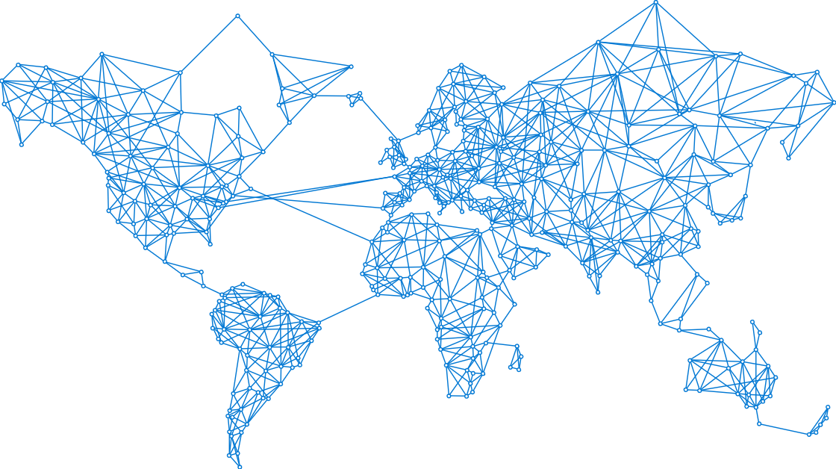
Azure regions
7
Azure OpenAI Service regions
More than AWS & Google combined
Notes:
NEXT: Datacenter video

Slide 12
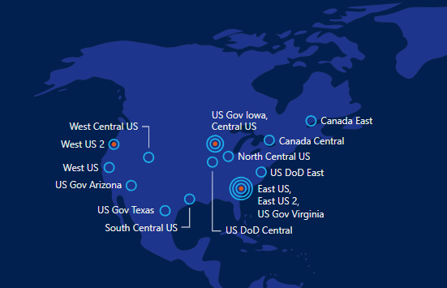
North American Datacenters

Slide 13
How do we Interact with Azure?
AZ CLI
Is a CMD interface that can execute commands
Az PowerShell Modules
Useful for Automation and working with Azure from within Azure
Graph API
Sorta, It’s more for interacting with M365, but can still be useful
One of the 100 portals
Why type when you can click?

Slide 14
100 Portals?
100 portals is what happens when you have 100 developers that think they know better than the other 99.
Administrator Portals | MSPortals.io - Microsoft Portals
The Important ones (that we’ll cover)
portal.azure.com
rc.portal.azure.com
preview.portal.azure.com
resources.azure.com
dev.azure.com
There is no “Production” Portal ;) You should be doing IaC!

Slide 15
Death by 100 Portals
Yup, It’s plural. Because why settle for one portal when you can have 100…. No, Seriously

Slide 16
Azure Networking

Slide 17
Azure Networks
Virtual Networks in Azure are just like your datacenter
Until you talk about DNS
Private Endpoints allow many Azure services to become private and local to your network
Let’s talk about that DNS
Azure Private Resolvers allow you to resolve DNS records from Azure, do conditional forwards, and auto-manage record lifecycles
Virtual Networks are normally isolated and cannot talk to each other.
Virtual Network Peering allows one or more networks to talk to each other
Virtual Network Peering costs money

Slide 18
Public Endpoints
Public?, Well, yeah, It’s in a public cloud afterall
By default, all services ingress and egress over a public interface
Many services support private endpoints which allow ingress to be private, but egress is still public.
Some services support Vnet Integration which allows both ingress and egress to be private.
There are use valid use-cases for all of the above.

Slide 19
Private Endpoint Structure (According to CoPilot)
+-------------------+ +-------------------+
| | | |
| Your Virtual | | Azure Service |
| Network | | |
| | | |
| +--------------+ | | +---------------+ |
| | Private | | | | | |
| | Endpoint | | | | | |
| | | | | | | |
| | +---------+ | | | | +-----------+ | |
| | | | | | | | | | | |
| | | Subnet | | | | | | Resource | | |
| | | | | | | | | | | |
| | +---------+ | | | | +-----------+ | |
| | | | | | | |
| +--------------+ | | +---------------+ |
| | | |
+-------------------+ +-------------------+

Slide 20






Private Endpoint Structure (According to Scott)
Virtual Network 10.10.0.0/16
10.10.1.0/24
sqlserver1.privatelink.database.windows.net
10.10.2.0/24
sqlserver1.database.windows.net
10.10.2.16
10.10.3.0/24
privatelink.database.windows.net
A Record: sqlserver1 = 10.10.2.16

Slide 21
Private Endpoints (How they work)
User looks for sqlserver1.database.windows.net
Users Local DNS
User queries DNS for
sqlserver1.database.windows.net
No Fwd Lookup Zone
Azure Global DNS
No Zone for database.windows.net
Alias Returned
Global DNS Returns Alias for
privatelink.database.windows.net
Private Link Configuration Found
New DNS Query for Alias
Users Local DNS
User queries DNS for
sq1server1.privatelink.database.windows.net
10.10.2.16
Fwd Lookup Zone exists

Slide 22
Azure Networks
Now we can blame our DNS problems on Microsoft AND the network team

Slide 23
Compute options for all types of apps
Entry level
Burstable
General Purpose
Compute Intensive
Storage Optimized
A
Av2
B
D
Dv2
Dv3
F
Fv2
L
High Performance Computing
Memory Optimized
Graphics Intensive
Purpose-built SAP HANA
G
Ev3
M
NC
NCv2
NV
ND
H
HANA
NCv3
NVv2
NDv2
Notes:
Key Messages: This slide simply sets the stage. Azure compute offers a rich development environment and IaaS capabilities that can help you develop a broad range of applications. For each type of application you can select the right VM that best suits your needs. We continue to expand and enrich the variety of VMs available to you so you can continue to fuel your innovation and growth to Azure.
Products recently introduced include:
1. M-Series VMs now certified for SAP HANA. You can now develop applications on Azure for the SAP HANA platform that has been recently certified for M-Series. The M-series family of Azure virtual machines are the largest memory-optimized VMs to date. These VMs are ideal for heavy in-memory workloads such as SAP HANA. With the M-Series, these databases can load large datasets into memory and utilize the fast memory access with huge amounts of vCPU parallel processing to speed up queries and enable real-time analytics. You can deploy these large workloads in minutes and on-demand, scaling elastically as your usage demands. Refer to the blog for the announcement https://azure.microsoft.com/en-us/blog/azure-m-series-vms-are-now-sap-hana-certified/
2. NVIDIA’s latest GPU for HPC and AI is available in Azure. For those of you focused on HPC applications and AI, not too long ago we announced major expansion of our GPU fleet. NVIDIA GPUs are at the heart of a lot of discovery and innovation. And with our tools like Batch, Batch AI, and the Data Science Virtual Machine images, Azure customers and developers are in a great position to expand what is possible and bring to market innovative AI and HPC applications.https://azure.microsoft.com/en-us/blog/ncv3-vms-generally-available-other-gpus-expanding-regions/ NCv3 brings NVIDIA’s latest GPU – the Tesla V100 – to our best-in-class HPC, machine learning, and AI products to bring huge amounts of value across a variety of industries. One preview customer told us their speech recognition models trained in less than 20 minutes, instead of the 1-2 hours that previous generation GPUs required. Another customer told us about the 40-50% performance boost they saw on their reservoir simulations. The ND-series, powered by NVIDIA Tesla P40 GPUs based on the new Pascal Architecture, will be excellent for training and inference. These instances will provide more than twice the performance over the previous generation for AI workloads utilizing CNTK, TensorFlow, Caffe, and other frameworks. The ND-series also offer a much larger GPU memory size (24 gigabytes), enabling you to fit much larger neural net models. Also, like our NC-series, the ND-series will offer RDMA and InfiniBand connectivity, so you will be able to run large-scale training jobs spanning hundreds of GPUs.
3. We have also announced two new VM sizes, E64i_v3 and E64is_v3, which are isolated to hardware and dedicated to a single customer. These VMs are best suited for workloads that require a high degree of isolation from other customers for compliance and regulatory requirements. You can also choose to further subdivide the resources by using Azure’s support for nested VMs. The E64i_v3 and E64is_v3 will have the exact same performance and price as their cousins E64_v3 and E64s_v3 and will be available in each of the regions where E64_v3 and E64s_v3 are available today. The small letter ‘i’ in the VM name denotes that they are “Isolated” sizes. Unlike the E64_v3 and E64s_v3, the two new E64i_v3 and E64is_v3 sizes are hardware bound sizes. They will live and operate on our Intel® Xeon® Processor E5-2673 v4 2.3GHz hardware only and will be available until at least December 2021. We will provide reminders 12 months in advance of the official decommissioning of the sizes and offer an updated isolated size like these sizes on our next hardware version. These two new E64i_v3 and E64is_v3 sizes will be available in the on-demand portal. Starting on May 1st, 2018, they will also be made available for purchase as 1-year Reserved VM Instances.
The E64i_v3 and E64is_v3 are joining our other Isolated VM sizes in the Azure family:
Standard_D15_v2
Standard_DS15_v2
Standard_E64i_v3
Standard_E64is_v3
Standard_F72s
Standard_G5
Standard_GS5
Standard_L32s
Standard_M128ms
Standard_M128s
We encourage you to use these VMs for workloads needing a high degree of isolation.
----------------------------------------
BACKGROUND INFO
Entry Level
A-series VMs have CPU performance and memory configurations best suited for entry-level workloads like development and test. They are economical and provide a low-cost option to get started with Azure.
Example use cases include development and test servers, low-traffic web servers, small-to-medium databases, servers for proof-of-concepts, and code repositories.
Burstable
B-series are economical virtual machines that provide a low-cost option for workloads that typically run at a low-to-moderate baseline CPU utilization, but sometimes need to burst to significantly higher CPU utilization when the demand rises.
Example use cases include development and test servers, low-traffic web servers, small databases, micro services, servers for proof-of-concepts, and build servers.
General Purpose
The Dv3 and Ev3 sizes are able to run Windows 2016 hosts and enable Nested Virtualization and Hyper-V Containers for these new VM sizes. Nested virtualization allows you to run a Hyper-V server on an Azure virtual machine. With nested virtualization, you can run a Hyper-V Container in a virtualized container host, set up a Hyper-V lab in a virtualized environment, or to test multi-machine scenarios. You can find more information on Nested Virtualization on Azure.
Our new Dv3 VM sizes are a good balance of memory to vCPU performance, with up to 64 vCPUs and 256 GiB of RAM. Our newly named Ev3 sizes provide you with more memory to vCPU than the Dv3, so you can run larger workloads on sizes up to our largest E64 size, with 64 vCPUs and 432 GiB of RAM. D2v3 instances are the latest hyper-threaded generation of general purpose instances.
Compute Intensive
The F-series VM sizes sport a higher CPU-to-memory ratio. They feature 2 GB RAM and 16 GB of local Solid State Drive (SSD) per CPU core, and are optimized for compute-intensive workloads. The F-series is based on the 2.4 GHz Intel Xeon E5-2673 v3 (Haswell) processor, which can achieve clock speeds as high as 3.1 GHz with the Intel Turbo Boost Technology 2.0. Example use cases include scenarios like batch processing, web servers, analytics, and gaming.
Azure now offers the fastest Intel Xeon Scalable processor, code-named Skylake, in the public cloud. In Azure, we have seen growing demand for massive large-scale computation by customers doing financial modeling, scientific analysis, genomics, geothermal visualization, and deep learning. Our drive to continuously innovate in Azure allows us to offer cost-effective and best-in-class hardware for these world-changing workloads.
Memory Optimized
The M-series family of Azure virtual machines are the largest memory optimized VMs to date. These VMs are ideal for heavy in-memory workloads, such as SAP HANA. With the M-series, these databases can load large datasets into memory and utilize the fast memory access with huge amounts of vCPU parallel processing to speed up queries and enable real-time analytics. You can deploy these large workloads in minutes and on-demand, scaling elastically as your usage demands.
G-series VMs feature the latest Intel Xeon processor E5 v3 family, two times more memory, and four times more Solid State Drive storage (SSDs) than the General Purpose D-series. G-series sport RAM of up to ½ TB and 32 CPU cores, and provide unparalleled computational performance, memory, and local SSD storage for your most demanding applications. Example use cases include large SQL and NoSQL databases, ERP, SAP, and data warehousing solutions.
Optimized for in-memory hyper-threaded applications, the E-series family of Azure virtual machines are optimized for heavy in-memory applications such as SAP HANA. These VMs are set up with high memory-to-core ratios that make them well-suited for relational database servers, with medium-to-large caches, and in-memory analytics. The E-series VMs range from 2 to 64 vCPUs and 16 to 432 GiB RAM, respectively.
Two new VM sizes, E64i_v3 and E64is_v3, which are isolated to hardware and dedicated to a single customer. These VMs are best suited for workloads that require a high degree of isolation from other customers for compliance and regulatory requirements. The E64i_v3 and E64is_v3 will have the exact same performance and price as their cousins E64_v3 and E64s_v3, and they will be available in each of the regions where E64_v3 and E64s_v3 are available today. The small letter “I” in the VM name denotes that they are “Isolated” sizes.
Graphics Intensive
NCv3 is available in East and South Central regions in the US. NCv3 brings NVIDIA’s latest GPU – the Tesla V100 – to our best-in-class HPC, machine learning, and AI products to bring huge amounts of value across a variety of industries. One preview customer told us their speech recognition models trained in less than 20 minutes, instead of the 1-2 hours that previous generation GPUs required. Another customer told us about the 40-50% performance boost they saw on their reservoir simulations.
The ND-series, powered by NVIDIA Tesla P40 GPUs based on the new Pascal Architecture, will be excellent for training and inference. These instances will provide more than twice the performance over the previous generation for FP32 (single-precision floating-point operations), for AI workloads utilizing CNTK, TensorFlow, Caffe, and other frameworks. The ND-series also offer a much larger GPU memory size (24 gigabytes), enabling you to fit much larger neural net models. Also, like our NC-series, the ND-series will offer RDMA and InfiniBand connectivity, so you will be able to run large-scale training jobs spanning hundreds of GPUs. They are available in East and West US and Southeast Asia.
HPC
H-series VM sizes are suitable for any compute-intensive workload like complex engineering and scientific workloads like computational fluid dynamics, crash simulations, seismic exploration, and weather forecasting simulations. H-series VMs come with the fastest CPUs in public cloud, as well as RDMA with InfiniBand, which allows you to run high-performance computing (HPC) apps. The H-series is available across multiple regions in the US, Europe, and Asia.
Azure offers a comprehensive set of compute options for all types of apps, including entry-level, general purpose, memory optimized, storage optimized, and compute intensive.
Our HPC and GPU fleet has fast performance with built-in Infiband support. Let’s take a look at some of the new compute types we’ve added:
H-series: InfiniBand networking (industry-leading)
SAP Large Instances up to to 20 TB (industry-leading)
Fast networking (FPGA) – up to 30 gb/s from 25 gb/s last year (industry-leading)

Slide 24
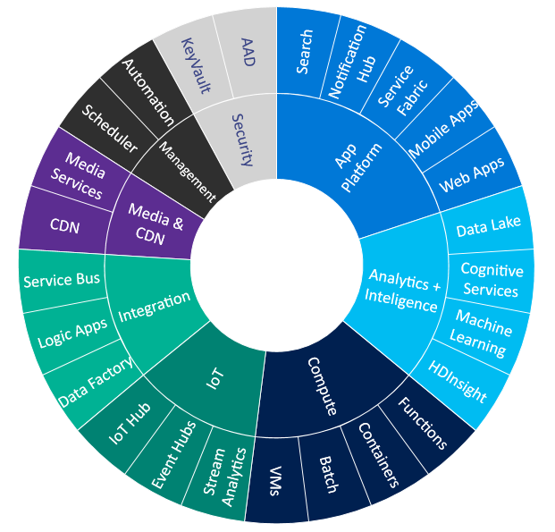
Blob Storage | Overview
Foundational service for Azure
Azure’s Object Storage platform
Store and serve EB of (un)structured data
Broad integration across Azure services
Blob Storage
Durable & Available
Secure & Compliant
Scalable & Performant
Open & Interoperable
Manageable & Cost Efficient
Notes:
Even using Azure CLI will require a storage

Slide 25


Azure Blob Tiers
Premium
Hot
Cool
Cold
Archive
Low and consistent latency data
Frequently accessed data
Less frequently accessed data
infrequently accessed with long term retention
Rarely accessed data
PER TB PER MONTH
$150.00
$20.40
$10.24
$4.61
$1.84
PER 10K READ OPERATIONS
$0.0014
$0.006
$0.01
$0.13
$7.80
RETRIEVAL TIMES
Immediate (SSD)
Immediate (HDD)
Immediate (HDD)
Immediate (HDD)
Hours
Interactive
Transactions
Telemetry
Cloud native application data storage
Repository for server backups
Data not in use but need to be available
Medical records archiving
USE CASE
EXAMPLES
Notes:
Ask customers to come talk afterwards if interested in cold storage tier with faster latency than Archive.

Slide 26
Azure Storage Durability (Replication Options)
Typically >300mi
Typically >300mi
Zone 1
Zone 2
Zone 3
Async
Async
Primary
Secondary
Primary
Secondary
LRS
3 replicas, 1 region
Protect against disk, node, rack failures
Write is ack’d when all replicas are committed
Superior to dual-parity RAID
11 9s of durability
GRS
6 replicas, 2 regions (3/region)
Protects against major regional disasters
Asynchronous to secondary
16 9s of durability
RA-GRS
GRS + Read access to secondary
Separate secondary endpoint
RPO delay to secondary can be queried
LRS
3 replicas, 1 region
Protect against disk, node, rack failures
Write is ack’d when all replicas are committed
Superior to dual-parity RAID
11 9s of durability (0 seconds of outage per year)
ZRS
3 replicas across 3 Zones
Protect against disk, node, rack and zone failures
Synchronous writes to all 3 zones
12 9s of durability
Available in 8 regions

Slide 27
Azure Storage
Because we talked long enough

Slide 28
Azure Governance

Slide 29
Azure Governance
Because we can’t just have fun all the time
Policies, Cost Management, Permissions, and Standards are just as, if not more important, than everything else
Controls should come first and be in place before any resources get deployed
Azure is not your datacenter, make sure you plan accordingly

Slide 30
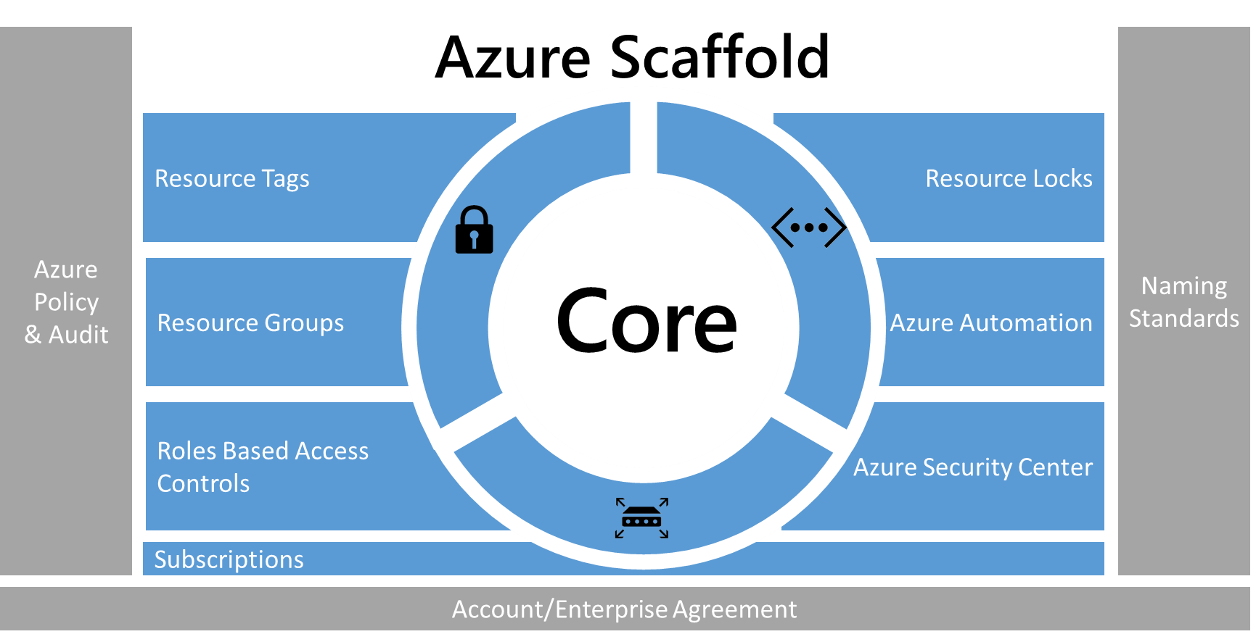
What is Azure Governance?
Azure Governance: https://aka.ms/edu/governance
Notes:
(Introductions and set expectations that this presentation is designed to discuss the role of Azure as the cloud computing platform for a business’s digital transformation.)
Easy definition – Set of services designed to make your life easier.

Slide 31

Example Enrollment Hierarchy
Enrollment
Enrollment
Typically, 1 per company
Tied to your company's Microsoft account
Roll-up billing from all Subscriptions
Account owners created & delegated at this level (NOT Subscriptions)
Account
Account
Subscription
Created & owned by an Account owner
An administrative & security boundary - each Subscription has its own administrators
Each Subscription is a billing unit
A logical limit of scale by which resources can be allocated
No incremental cost for creating multiple Subscriptions
A Subscription is accountable for its own consumption and standards
Container for Resource Groups, who inherit Subscription standards
Sub
Sub
Sub
Sub
Sub
Resource Groups
Where your users actually build and deploy Azure services (VMs, Websites, Backup, Research, etc.)
Functions as Security and Billing container
Where RBAC is applied at lowest level

Slide 32
Best Practices

Slide 33
Cloud pricing journey
Different pricing actions correspond to different milestones in your cloud journey.
Consider Azure
Assess and plan
Deploy
Manage and optimize
Set up the platform for success.
Understand value and build confidence.
Prepare for moving forward with project and build a plan.
Establish management and optimization excellence.
Pricing needs through the journey
Understand how Azure pricing works
Estimate project costs on Azure
Budget for specific Azure services
Optimize spend for Azure workloads

Slide 34
What Is A Subscription?
A Subscription Is Where You Actually Deploy Azure Resources
Can Be Considered A ‘Billing Container’
Can Be Considered A ‘Security Container’
Does Have Scale Limits, Though Very High
10,000 VMs Per Region
200 Storage Accounts Per Region
https://aka.ms/edu/limits
Notes:
(Introductions and set expectations that this presentation is designed to discuss the role of Azure as the cloud computing platform for a business’s digital transformation.)

Slide 35
Important Decisions
Identify Roles Who Will Be:
Subscription Owners
Other Access Models Such As Read Only
RBAC Options Further Defined When We Get To Azure AD & Resource Groups Later
Doesn’t need to be perfect out of the gates but does need to be pointed in the right direction.
Notes:
(Introductions and set expectations that this presentation is designed to discuss the role of Azure as the cloud computing platform for a business’s digital transformation.)

Slide 36
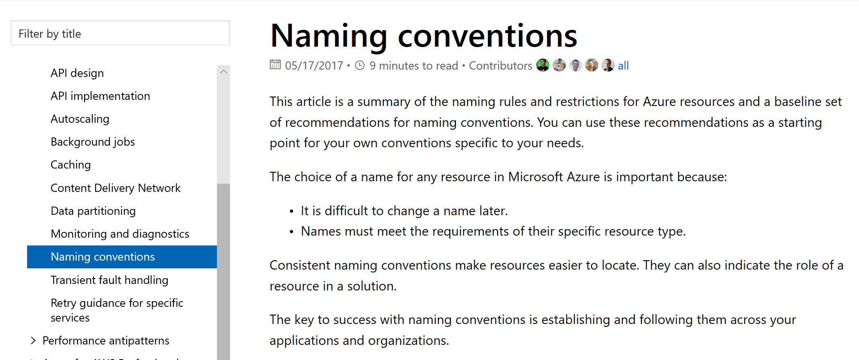
Name and Tagging Best Practice
Using the best practices from Microsoft's website https://docs.microsoft.com/en-us/azure/architecture/best-practices/naming-conventions

Slide 37
Why do we need Naming and Tagging Standards?
Consistent naming conventions make resources easier to locate. They can also indicate the role of a resource in a solution.
Tags can help by adding additional metadata to give further information about the resource(s) e.g. Cost Center, Owner, Compliance requirements
Tag Pairs will help audit and organize billing data for the organization.
Can enable or help with Chargebacks/Back Billing
Remember that some services have different naming restrictions (such as allowed characters or length)
Notes:
After you apply tags, you can retrieve all the resources in your subscription with that tag name and value. Tags enable you to retrieve related resources from different resource groups. This approach is helpful when you need to organize resources for billing or management.

Slide 38

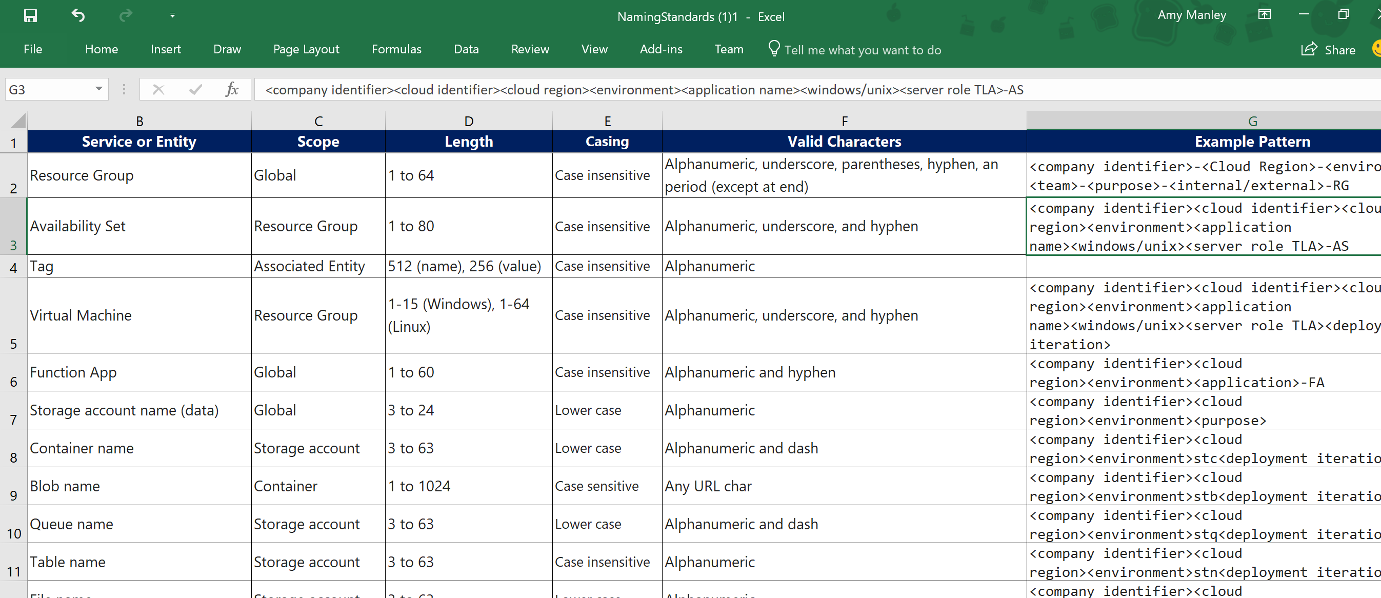
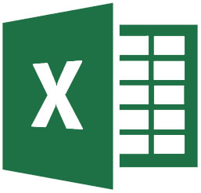
Standards are Everything!
Notes:
There are templates out there. Standards are key

Slide 39
Tagging is mandatory for better accountability
Tags should be enforced by configuration policy
Use Azure Policy to set and track ARM tagging policies
Tags should include 3 types of information
Billing information: cost center, billing ID, etc.
Ownership information: whom should be contacted when needed
Purpose information: environment, application service, etc.
Cost Management can help
Discovers ARM Resource Group tags and automatically associate to underlying resources
Has rules for standardizing, rewriting, adding meta-tag values
Tag your resources

Slide 40
Resource Tags
Maximum 15 per resource or resource group
Tags span resource groups, allowing you to link and correlate entities across disparate deployments.
Some of the common tagging use cases are:
Billing; Grouping resources and associating them with billing or charge back codes.
Service Context Identification; Identify groups of resources across Resource Groups for common operations and grouping
Access Control and Security Context; Administrative role identification based on portfolio, system, service, app, instance, etc.
Using tags to organize your Azure resources

Slide 41
Azure Government
I Mean Governance

Slide 42
Automation Tools for Azure

Slide 43
Infrastructre as Code + Configuration as Code FTW
Azure DevOps Pipelines
Azure Automation
Azure LogicApps
Azure Functions
Azure PowerShell
Azure CLI
ARM Templates
Bicep
Terraform*
Ansible*
* Third Party Products that may require additional licensing outside of your Microsoft contract

Slide 44
Summary
Imperative, ad-hoc cross-platform scripting
Azure PowerShell and Azure CLI
Deployment using a declarative model is the real deal
ARM templates, Terraform, Ansible, and Building Blocks (infrastructure management)
Chef, Puppet, Ansible, and DSC (VM configurations)
Use Azure Cloud Shell within Visual Studio Code

Slide 45
Automating the Cloud
Like cloud seeding, but less controversial…

Slide 46
Security and Monitoring

Slide 47

Unmatched security across operations, technology, and partnerships
Operations
Secure foundation and intelligence
$1B annual investment in cybersecurity
3500+ global security experts
Trillions of diverse signals for unique intelligence
Azure Security
Technology
Partnerships
Built-in controls
For a heterogeneous world

Slide 48
Manage organizational security policies and assess compliance in minutes
Highly Dynamic Environment
Manage security policies at an organizational level
Easily set security policies for subscriptions or management groups
Instantly understand your current policy compliance and review compliance overtime
!
!
!
!
!
New machine
without AV
PCI Non-compliance
Unencrypted SQL server
Insecure Subnet
Remote connection left open

Slide 49

Protect Linux and Windows servers from threats
On-premise
Azure, AWS, and GCP
Use Just-in-Time VM to control access to commonly attacked management ports
Enable controls to block malicious applications, especially those missed by antimalware solutions, from running
Protect Windows servers and clients with the integration of Windows Defender ATP and Linux servers
Antimalware
Defender ATP
Behavior analytics
App whitelisting
!
!
!
Malicious code execution
Data exfiltration
Lateral Movement

Slide 50
Security
The only way that we get to pretend to be cops that doesn’t get us in trouble… more trouble

Slide 51
Q&A Thank You

Slide 52

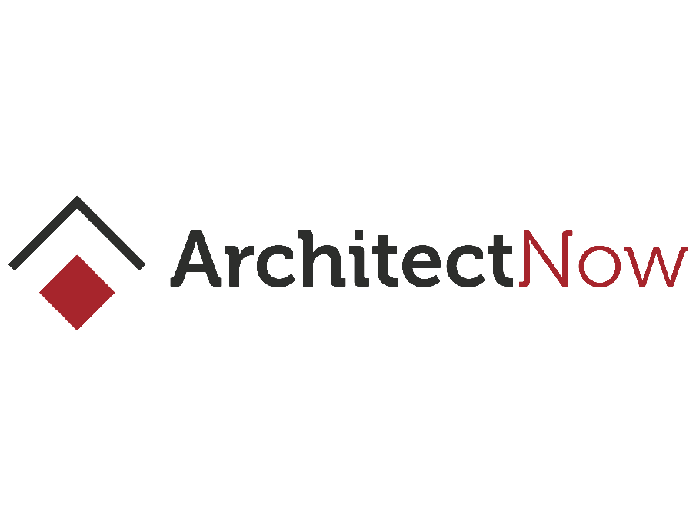

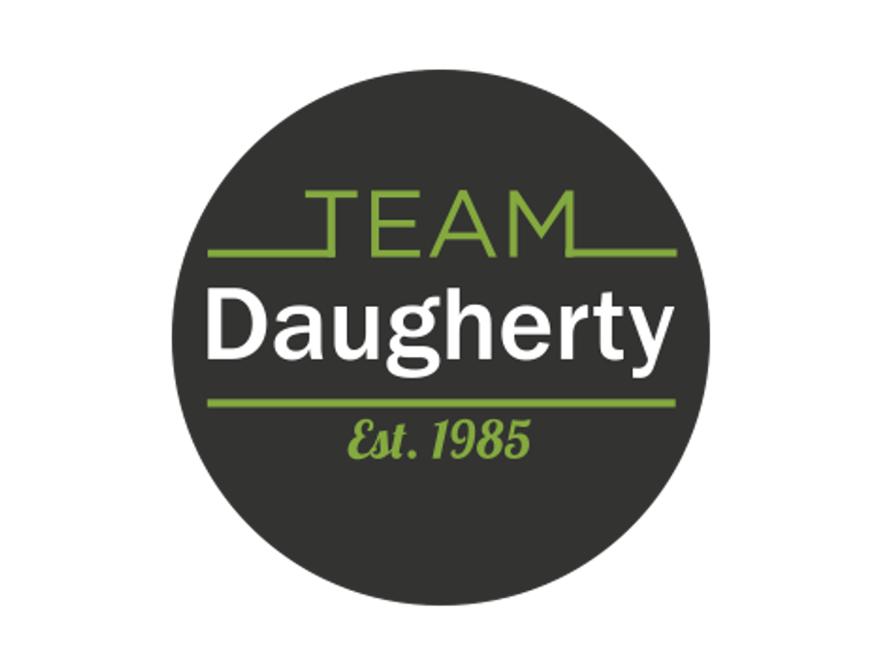

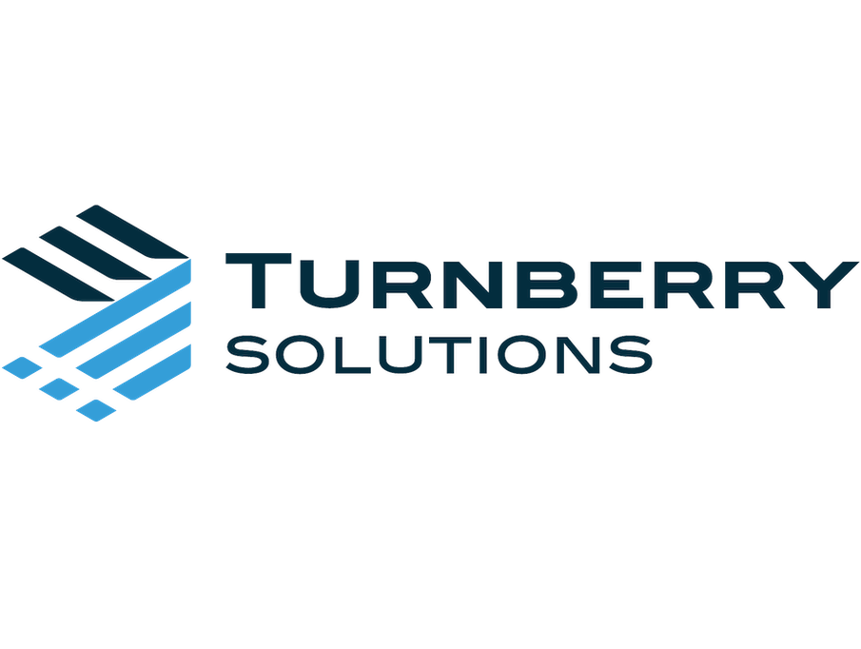
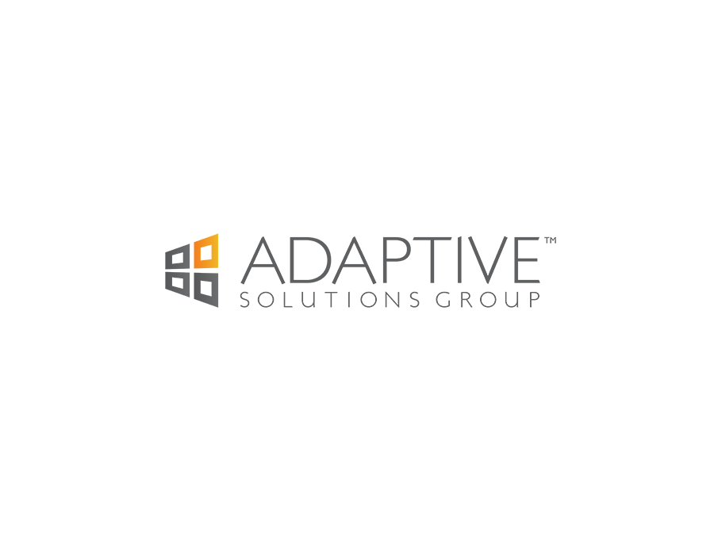
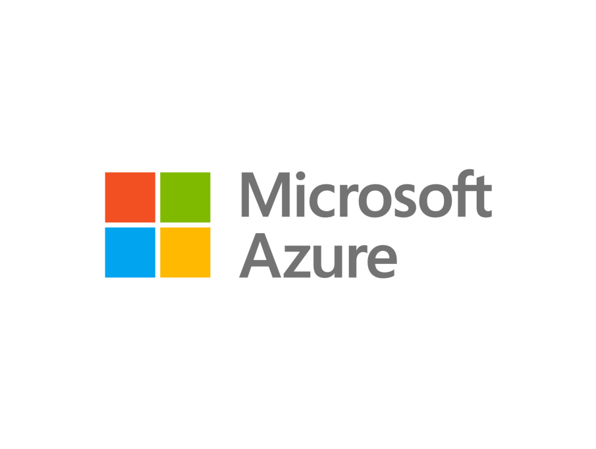
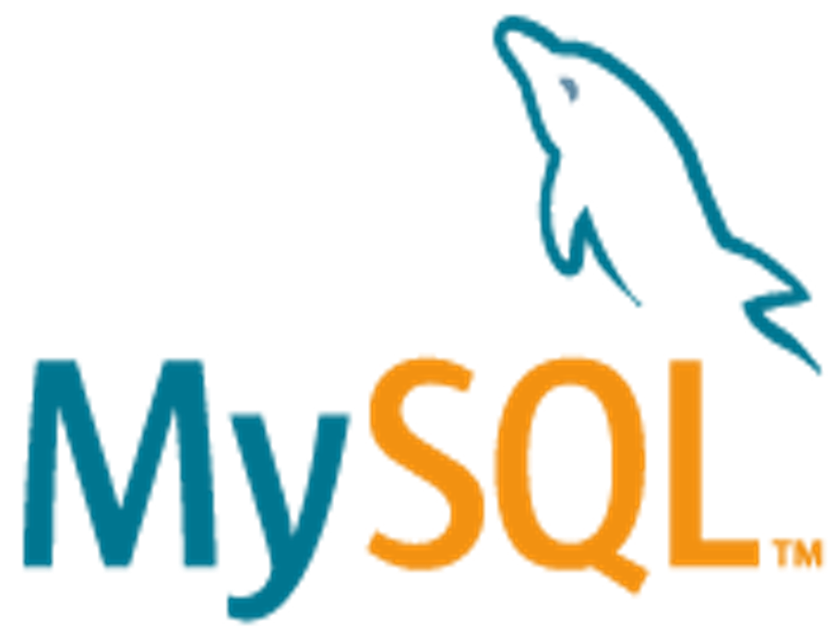


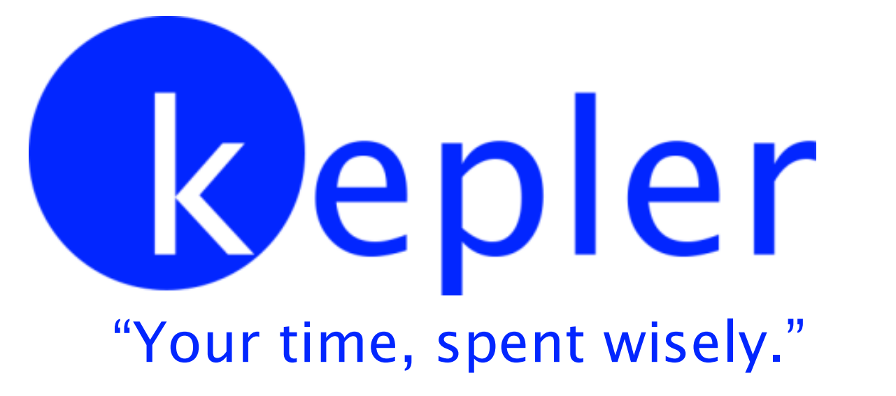

Thank you to our Sponsors!

